Slide 1


SRI KRISHNA INSTITUTE OF TECHNOLOGY DEPARTMENT OF COMPUTER SCIENCE AND ENGINEERING
PROJECT PHASE 2 SEMINAR -1
ON
Crypto-currency price prediction using machine learning
PRESENTED BY UNDER THE GUIDANCE OF
1. Prabhat Kumar (1KT19CS061) Guide Name :Mr. Imran Ulla Khan
2. Rohan Yadav C (1KT19CS072) Designation : Asst .Professor
3. V. Rudrateja Reddy ( 1KT19CS073)
4. P. Sandeep Kumar (1KT19CS057)
DATE: 11/03/23 BATCH NO : B 20
Notes:
1

Slide 2
INTRODUCTION
SRI KRISHNA INSTITUTE OF TECHNOLOGY DEPARTMENT OF COMPUTER SCIENCE AND ENGINEERING
Crypto-currency is a digital currency, enabled by the blockchain technology and allows for peer-to-peer transactions secured by cryptography.
In this study, we analyze the short-term predictability of the bitcoin market.
Therefore, we utilize a variety of machine learning methods and consider a comprehensive set of potential market-predictive features.
Machine learning methods have been applied increasingly within this domain, due to the ability to flexibly select amongst a potentially large number of features and to learn complex, high-dimensional relationships between features and target.
DEPT. OF CSE SKIT

Slide 3
INTRODUCTION
SRI KRISHNA INSTITUTE OF TECHNOLOGY DEPARTMENT OF COMPUTER SCIENCE AND ENGINEERING
The less attention has been paid to the novel stream of cryptocurrency pricing.
In particular, the short-term predictability of the bitcoin market has not yet been analyzed comprehensively.
Furthermore, most studies have solely considered technical features and have not analyzed the feature importance of the employed machine learning models.
Against this backdrop, we tackle this research gap by comparatively analyzing different machine learning models for predicting market movements of the most relevant cryptocurrency—bitcoin.
DEPT. OF CSE SKIT

Slide 4
SRI KRISHNA INSTITUTE OF TECHNOLOGY DEPARTMENT OF COMPUTER SCIENCE AND ENGINEERING
REQUIREMENTS
HARDWARE REQUIREMENTS :
Processor : Pentium IV.
System : intel i3/i5, 2.4 GHz.
RAM : 4 to 8 GB.
Hard Disk : 40 GB.
SOFTWARE REQUIREMENTS :
PYTHON 3.10+ ver (Training to Machine Learning)
Python (BACKEND)
Django(FRONTEND)
Dataset(Cryptocompare API).
Operating System : Window 7 and above, MacOs, Linux
DEPT. OF CSE SKIT

Slide 5
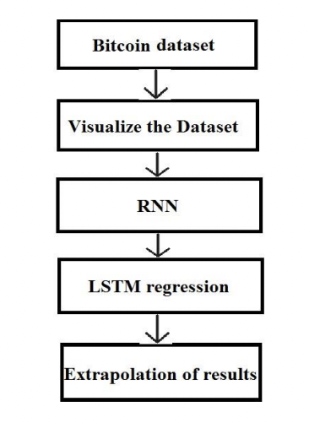
SRI KRISHNA INSTITUTE OF TECHNOLOGY DEPARTMENT OF COMPUTER SCIENCE AND ENGINEERING
SYSTEM DIAGRAM
Fig : work-flow of proposed model
DEPT. OF CSE SKIT

Slide 6
IMPLEMENTATION DETAILS
SRI KRISHNA INSTITUTE OF TECHNOLOGY DEPARTMENT OF COMPUTER SCIENCE AND ENGINEERING
1. Install the following libraries in Python:
pandas
numpy
scikit-learn
Django
2. Set up a new Django project.
3. Create a new Django app within the project directory.
4. Collect historical data for the selected cryptocurrency from an online source or an
API. For this example, we will be using the Cryptocompare API to retrieve
historical data. You will also need to preprocess the data to prepare it for machine
learning modeling.
5. Train a machine learning model using the preprocessed data to predict the future
prices and returns of the cryptocurrency.
DEPT. OF CSE SKIT

Slide 7
SRI KRISHNA INSTITUTE OF TECHNOLOGY DEPARTMENT OF COMPUTER SCIENCE AND ENGINEERING
6. Define views for the Django app that will handle the user input and return the
predicted results.
7. Define a form for the user input in the Django app.
8. Define the HTML templates for the web pages in the Django app.
9. Define the URLs for the views in the Django app.
10. Run the Django app by running the following command in the terminal:
DEPT. OF CSE SKIT

Slide 8
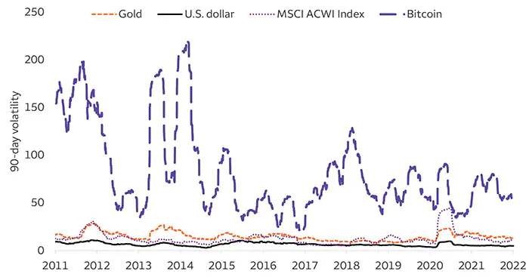
SRI KRISHNA INSTITUTE OF TECHNOLOGY DEPARTMENT OF COMPUTER SCIENCE AND ENGINEERING
IMPLEMENTED STATUS
DEPT. OF CSE SKIT

Slide 9
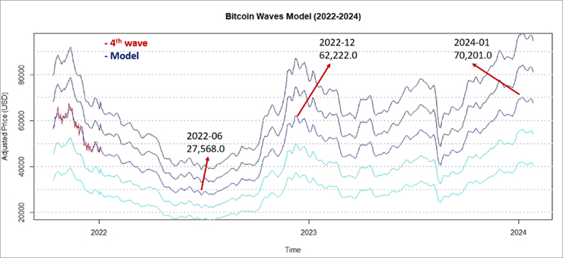
SRI KRISHNA INSTITUTE OF TECHNOLOGY DEPARTMENT OF COMPUTER SCIENCE AND ENGINEERING
IMPLEMENTED STATUS
DEPT. OF CSE SKIT

Slide 10
SRI KRISHNA INSTITUTE OF TECHNOLOGY DEPARTMENT OF COMPUTER SCIENCE AND ENGINEERING
NETWORK FRAMEWORK
ICON
ICON is a blockchain technology and network framework designed to allow independent blockchains to interact with each other.
Communities are connected to the ICON Network through a decentralized exchange.
Potential opposition from traditional centralized cryptocurrency exchanges is a major challenge facing ICON.
DEPT. OF CSE SKIT

Slide 11
SRI KRISHNA INSTITUTE OF TECHNOLOGY DEPARTMENT OF COMPUTER SCIENCE AND ENGINEERING
To keep Cryptocurrency price prediction project up-to-date and accurate, we may need to make the following changes in the future:
Data source
Machine learning model
New cryptocurrencies
Additional features
Real-time prediction
DEPT. OF CSE SKIT

Slide 12
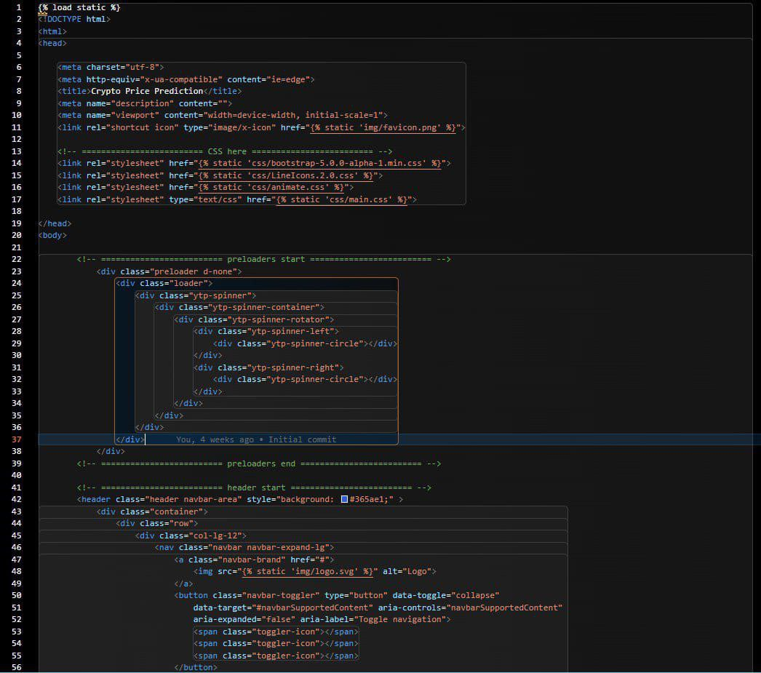
SRI KRISHNA INSTITUTE OF TECHNOLOGY DEPARTMENT OF COMPUTER SCIENCE AND ENGINEERING
Code
DEPT. OF CSE SKIT

Slide 13
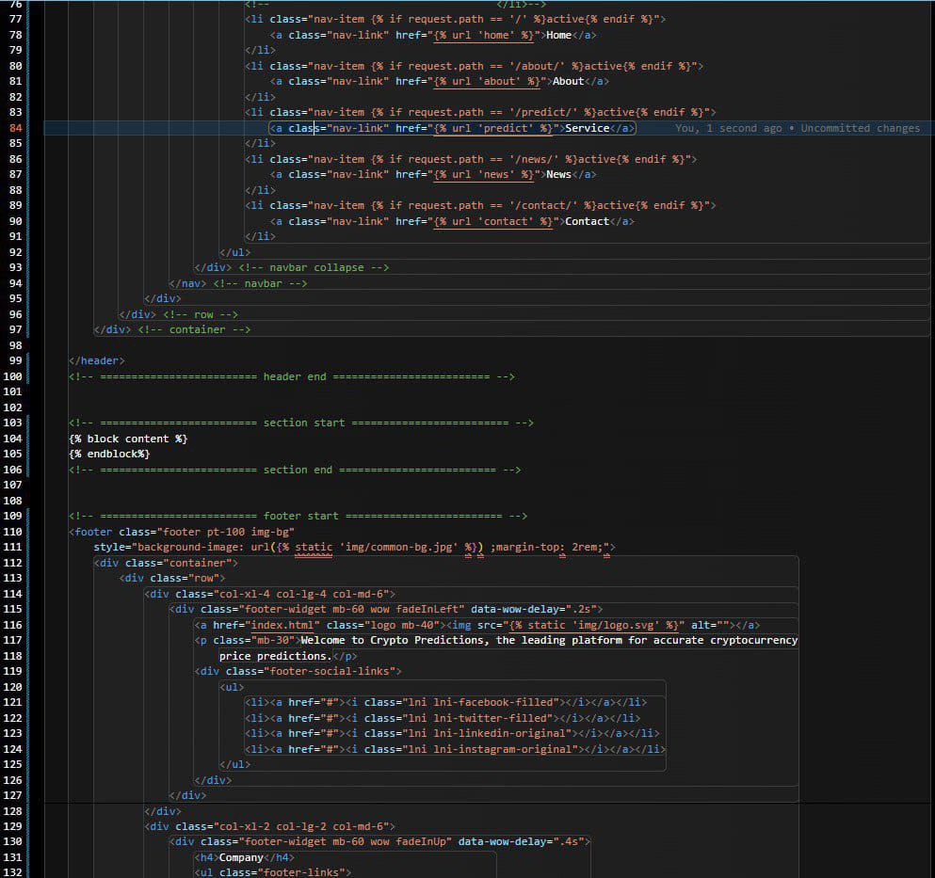
SRI KRISHNA INSTITUTE OF TECHNOLOGY DEPARTMENT OF COMPUTER SCIENCE AND ENGINEERING
DEPT. OF CSE SKIT

Slide 14
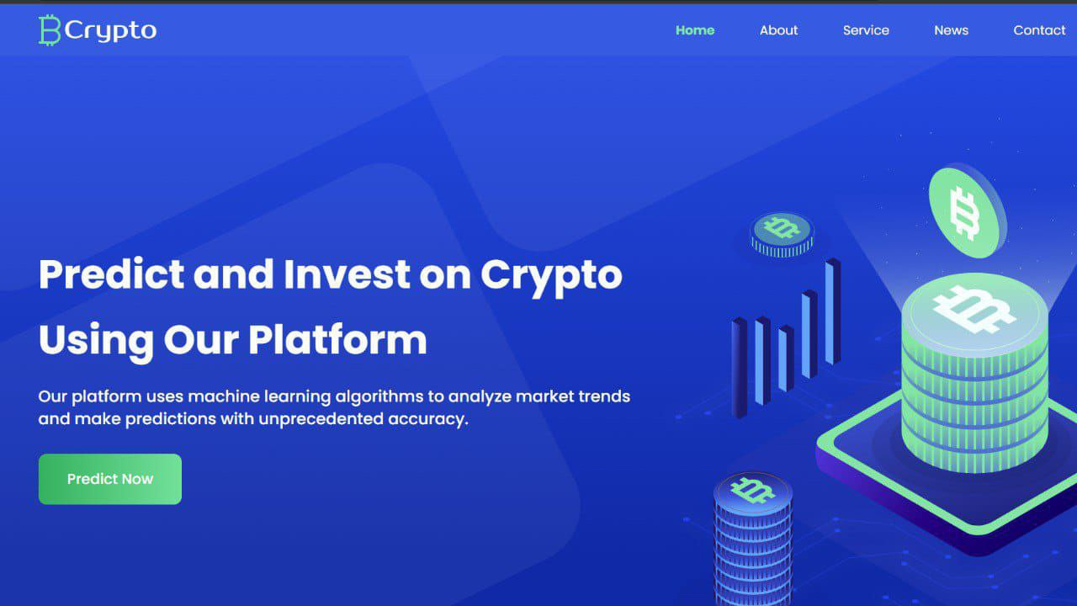
SRI KRISHNA INSTITUTE OF TECHNOLOGY DEPARTMENT OF COMPUTER SCIENCE AND ENGINEERING
Home Page
DEPT. OF CSE SKIT

Slide 15
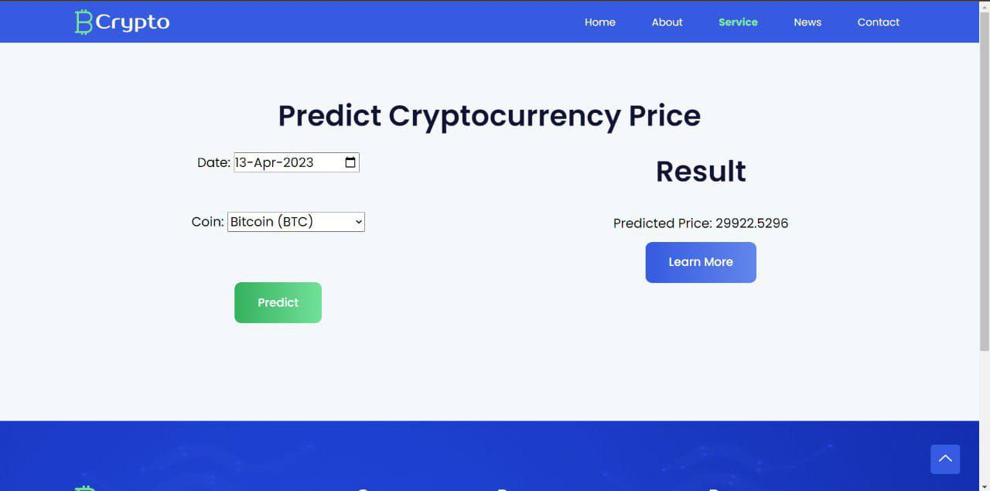
SRI KRISHNA INSTITUTE OF TECHNOLOGY DEPARTMENT OF COMPUTER SCIENCE AND ENGINEERING
Result
DEPT. OF CSE SKIT

Slide 16
SRI KRISHNA INSTITUTE OF TECHNOLOGY DEPARTMENT OF COMPUTER SCIENCE AND ENGINEERING
Thank you
DEPT. OF CSE SKIT

